Slide 1
Capstone Project
The Battle of Neighborhoods
Presentation
P.R.Sriram Kumar

Slide 2
1. Introduction
Background: Safety is a top concern when moving to a new area. If you don’t feel safe in your own home, you're not going to be able to enjoy living there.
Problem: This project aims to select the safest borough in London based on the total crimes, explore the neighborhoods of that borough to find the 10 most common venues in each neighborhood and finally cluster the neighborhoods using k-mean clustering.
Interest: Expats who are considering to relocate to London will be interested to identify the safest borough in London and explore its neighborhoods and common venues around each neighborhood.

Slide 3






Data Acq i ition Cleani
Data Acquisition: The data acquired for this project is a combination of data from
three sources:
The first data source of the project uses a London crime data that shows the crime per borough in London.
The second source of data is scraped from a wikipedia page that contains the list of London boroughs. This page contains additional information about the boroughs.
The third data source is the list of Neighborhoods in the Royal Borough of
Kingston upon Thames as found on the wikipedia page.

Slide 4
Data Cleaning: The data cleaning process for each of the three sources of data are done
separately.
From the London crime data, the crimes during the most recent year (2016) are only selected. The major categories of crime are pivoted to get the total crimes per the boroughs for each major category.
The second data is scraped from a wikipedia page using the Beautiful Soup library in python. Using this library we can extract the data in the tabular format as shown in the website.
The two data sets are merged on the Borough names to form a new data set. The purpose of this data set is to visualize the crime rates in each borough and identify the borough with the least crimes recorded during the year 2016.
A2er visualizing the crime in each borough we can find the borough with the lowest crime rate.The third data set is created, with the names of the neighborhoods and the name of the borough with the latitude and longitude obtained using Google Maps API geocoding.
The new data set is used to generate the 10 most common venues for each neighborhood using the Foursquare API, finally using k means clustering algorithm to cluster similar neighborhoods together.

Slide 5
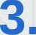

Methodo
Exploratory Data Analysis
Statistical summary of crimes
meen 208e.242424
194a.S4S45S 117B GUI 21
8010.1Z1212
TO41.848485 f2ROKB8B070
ZS13.801551 8828 874B 2S.000\XXI 178.I¥XXI£I€I
625.107070
2.00t IXXI
185ILOAX¥KI
58 400418
10.IAI0000
743 000
223.2B08B8
441.426300
rrdn Z.000Q€t
OXSL 1531.0000€O 60X 1071.000IXAf y63« 28s1.000Izz›
110.0000IKI
978.00¢XXXI
377.IXt000€I
1086.IAf0000 10BS.IAI0000
SZS1.aAzzz› 1617.¢zzI000
802IL0000IX'I
10780 AIOOtKI
740B.000tXAI 22730.IXXXI00
8832.000000 a7174.
max 3402.0000€B
SZ16.0000QI 2738.IAI0000
130S.00€¥XAI 1822.IAI00IXI
10834.00IXXXI 48330AXXItI0
The count for each of the major categories of crime returns the value 33 which is the number of London boroughs. ‘Theft and Handling’ is the highest reported crime during the year 2016 followed by ‘Violence against the person', ‘Criminal damage’. The lowest recorded crimes are ’Drugs', ’Robbery’ and ‘Other Notifiable offenses’

Slide 6


Boroughs with the highest crime rates
34071
Tower r : mJets
Comparing five boroughs with the highest crime rate during the year 2016 it is evident that Westminster has the highest crimes recorded followed by Lambeth, Southwark, Newham and Tower Hamlets. Westminster has a significantly higher crime rate than the other 4 boroughs.

Slide 7



Boroughs with the lowest crime rates
W@3
10658
17B
pon i names
Comparing five boroughs with the lowest crime rate during the year 2016, City of London has the lowest recorded crimes followed by Kingston upon Thames, Sutton, Richmond upon Thames and Merton.
City of London has a significantly lower crime rate because it i is the 33rd principal division of Greater London but it is not a London borough. It has an area of 1.12 square miles and a population of 7000 as of 2013 which suggests that it is a small area.
We will consider the next borough with the lowest crime rate as the safest borough in London which is Kingston upon Thames.

Slide 8
















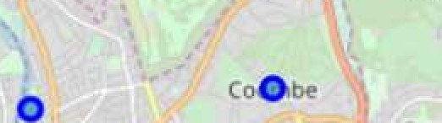



















































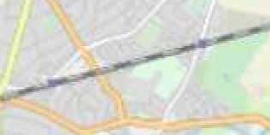




















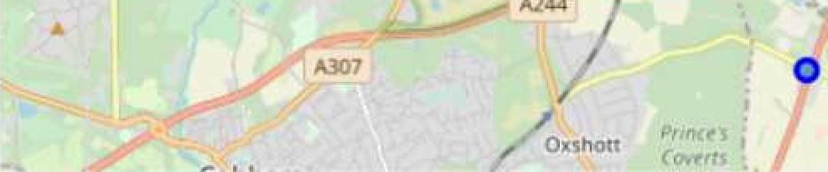


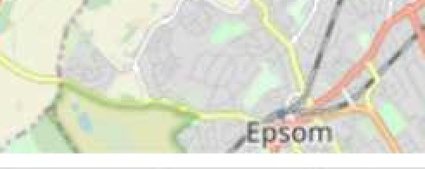
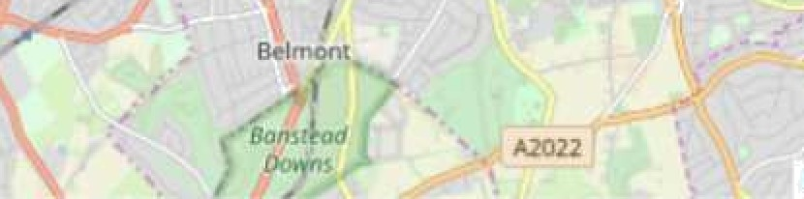
Neighborhoods in Kingston upon Thames
or ix'
Uerton’ Perk : ’
Mo1esey .
Maiden’
.. . / ’
. ’ ' .
’ £leddi 1g‹oi1”
’ ’ .’ : ladd
’. - ’’
Sutttin
Leaflet
There are 15 neighborhoods in the royal borough of Kingstân u.p,oi« Thames, they are visualised on a map using foIi.um on python.

Slide 9
Modelling
Using the final data set containing the neighborhoods in Kingston upon Thames along with the latitude and longitude, we can find all the venues within a 500 meter radius of each neighborhood by connecting to the Foursquare API.
 | Nelqhbarhood | Neighborhood Latitude | f4aighborhood Longitude | Vanue | Venue kaMtude | Ver | Longitude | Venue Category
0 | Berrylande | S1.30g781 | -0.284802 | S+abltrxs Racket & Fknecs Club | 51.392676 |  | -0.290Z24 | Gym / Ffizieea Center
S | Berrylanda | 51.393781 | •0.284B02 | Aaxaridra Park | 51.394230 |  | -0.2B4108 | Park
2 | Berrylands | 01.393781 | -0.284802 | K2 Bua Gtop | 01.382302 |  | -0.281534 | Bue Gtop
S | Berrylande | 51.393781 | -J2&B02 | Cafe Rasa | 51.390175 |  | -0.282480 | Cafe
 |  | 51.417499 |  | Tie Boater’e Inn | 51.418548 |  | -0.305B15 | Pub
One hot encoding is done on the venues data. The Venues data is then grouped by the Neighborhood and the mean of the venues are calculated, finally the 10 common venues are calculated for each of the neighborhoods.
To help people find similar neighborhoods in the safest borough we will be clustering similar neighborhoods using K - means clustering which is a form of unsupervised machine learning algorithm that clusters data based on predefined cluster size.
We will use a cluster size of 5 for this project that will cluster the 15 neighborhoods into 5 clusters. The reason to conduct a K- means clustering is to cluster neighborhoods with similar venues together so that people can shortlist the area of their interests based on the venues/amenities around each neighborhood.

Slide 10
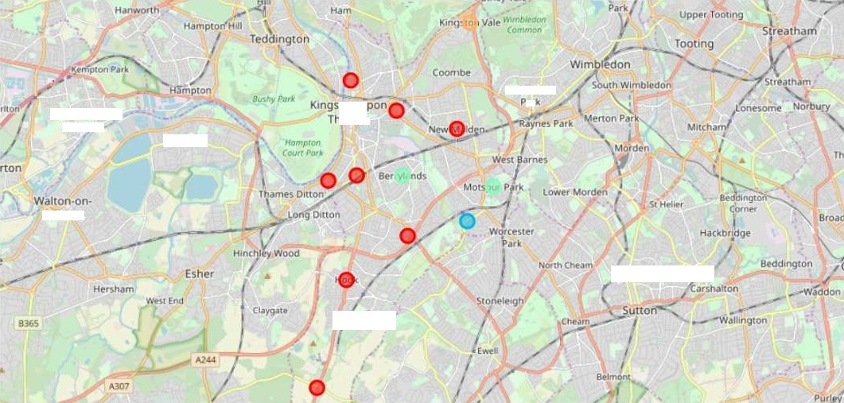
4.Results
Aher run’ni.nğ the .K•means clustering we can access eac¢ cluster.created to se.e which
netghborhoods were assigned to each .of the five clusters. Visualizìng, the clustered.
.neighborhoods. on a map using the folium lib.rary..
Each.cl.ust»r is coIo.r coded.,for th:». ease of presentation, we can see that .rnğ oîiØ of!he n»ip’hbîïrhöod fallü iü .ïhe red čIuster”a/hi«h íü yhe fïiüt cIüštër...”Thr»ë ùeiphbõrhoõdü hüve thëir own cluštër (Blu.é, Pürple .and Yellow)., thëse arë .clusters! two thré.e. añd. fiv».. Thë g,reen.cluster consists of two .neighborhoadš. whi«h, i!s the 4th cluster..

Slide 11
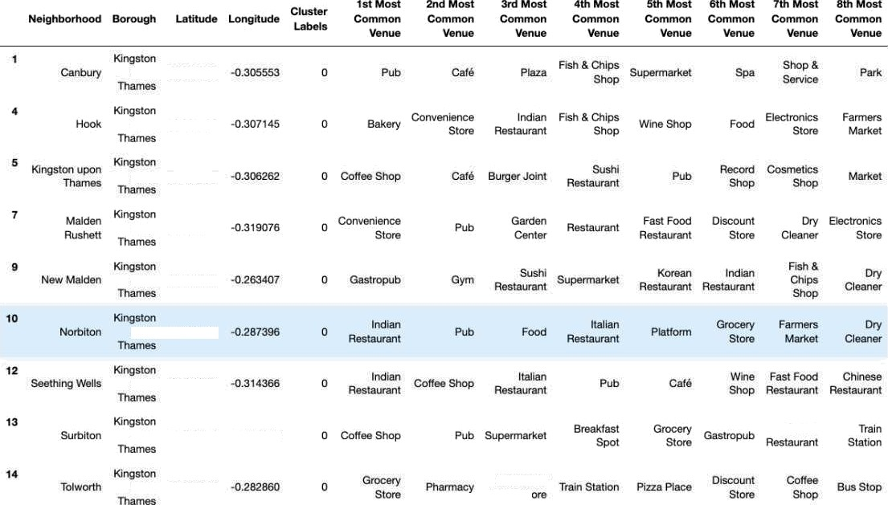

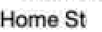
Cl.uster 1: L.ooki.ng in.to the neig.hborh.o.o.ds in the .first cIu.ster
upon 51417409
upon 51.3B7808
upon 51J41052.
up SI JBS758
-0.905310
Ffench
u.poci 51J78878
The. cluster on.e ’is the biggest .cluster o/ith 9 of the .15 neighborhoods in th.e b.orou.gh Kingston .u.pon Thames. Upon closely examining. these neigh.borhoods we can see that the most. comm.on venues in.th.es,e neighborhoods are Restauran.ts, Pubs, Cafe, Supermarkets, and .sto.res

Slide 12
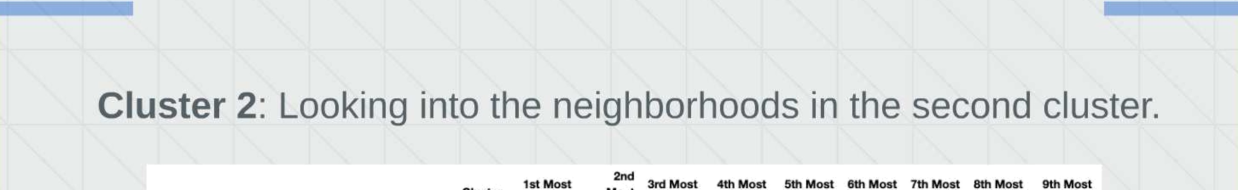









The thiré .cluster has one: neighb.orhood whi”ch consists of Venues such ” ”” as.Trai.n stati.ons., R.estaurants, an.d Furniture .shops.

Slide 13
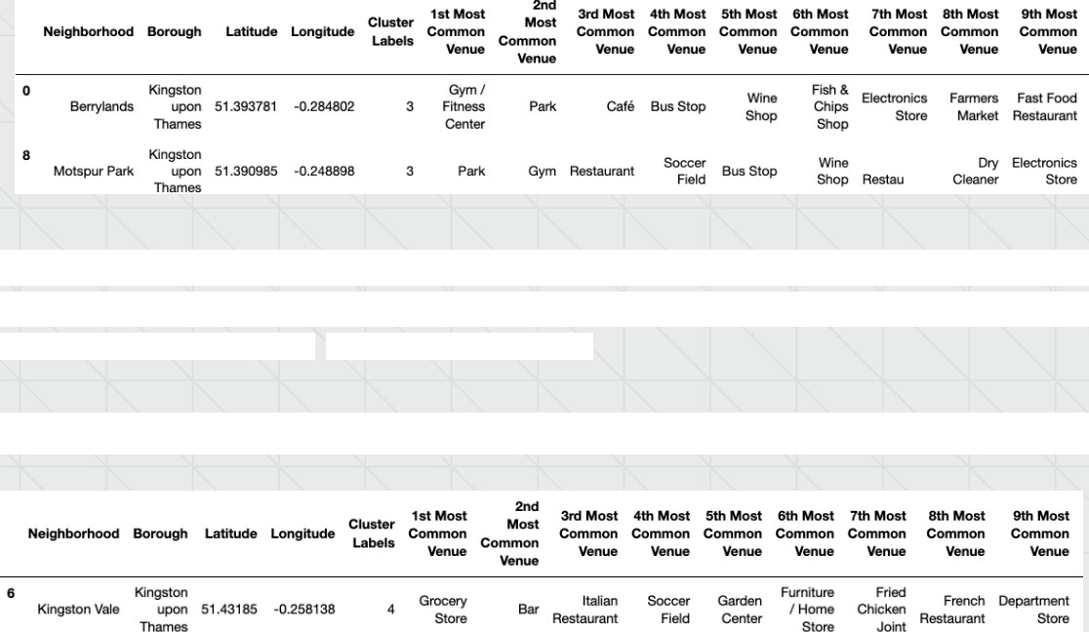
Cluster 4: Looking into the neighborhoods in the fourth cluster.
Fast Food
rant
The fourth cluster has two neighborhoods in it, these neighborhoods have common venues such as Parks, Gym/Fitness centers, Bus Stops, Restaurants, Electronics Stores and Soccer fields etc.
Cluster 5: Looking into the neighborhoods in the fourth cluster.
The fi2h cluster has one neighborhood which consists of Venues such as Grocery shops, Bars, Restaurants, Furniture shops, and Department stores.

Slide 14
5. Discussion
The aim of this project is to help people who want to relocate to the safest borough in London, expats can chose the neighborhoods to which they want to relocate based on the most common venues in it.
For example if a person is looking for a neighborhood with good connectivity and public transportation we can see that Clusters 3 and 4 have Train stations and Bus stops as the most common venues.
If a person is looking for a neighborhood with stores and restaurants in a close proximity then the neighborhoods in the first cluster is suitable.
For a family I feel that the neighborhoods in Cluster 4 are more suitable dues to the common venues in that cluster, these neighborhoods have common venues such as Parks, Gym/Fitness centers, Bus Stops, Restaurants, Electronics Stores and Soccer fields which is ideal for a family.
The preference of venues may vary from person to person, they can select a neighborhood based on ones priorities.

Slide 15
6.Conclusion
This project helps a person get a better understanding of the neighborhoods with respect to the most common venues in that neighborhood. It is always helpful to make use of technology to stay one step ahead i.e. finding out more about places before moving into a neighborhood.
We have just taken safety as a primary concern to shortlist the safest borough of London. The future of this project includes taking other factors such as cost of living in the areas into consideration to shortlist the borough, such as filtering areas based on a predefined budget.

